Slide 1
Serial Communications I2C
July 16th, 2025

Slide 2
What does it mean for computers to communicate?
You probably know that computers communicate with other computers using 1’s and 0’s
But you can’t just send a bunch of random 1’s and 0’s, they have to be packaged the right way – they need to follow a protocol
For instance, you probably know about one of the more famous protocols in use today – the Internet Protocol, IP
This is the protocol that allows computers all over the world to access and communication over the world wide web
And as you might imagine, it’s a bit complicated

Slide 3
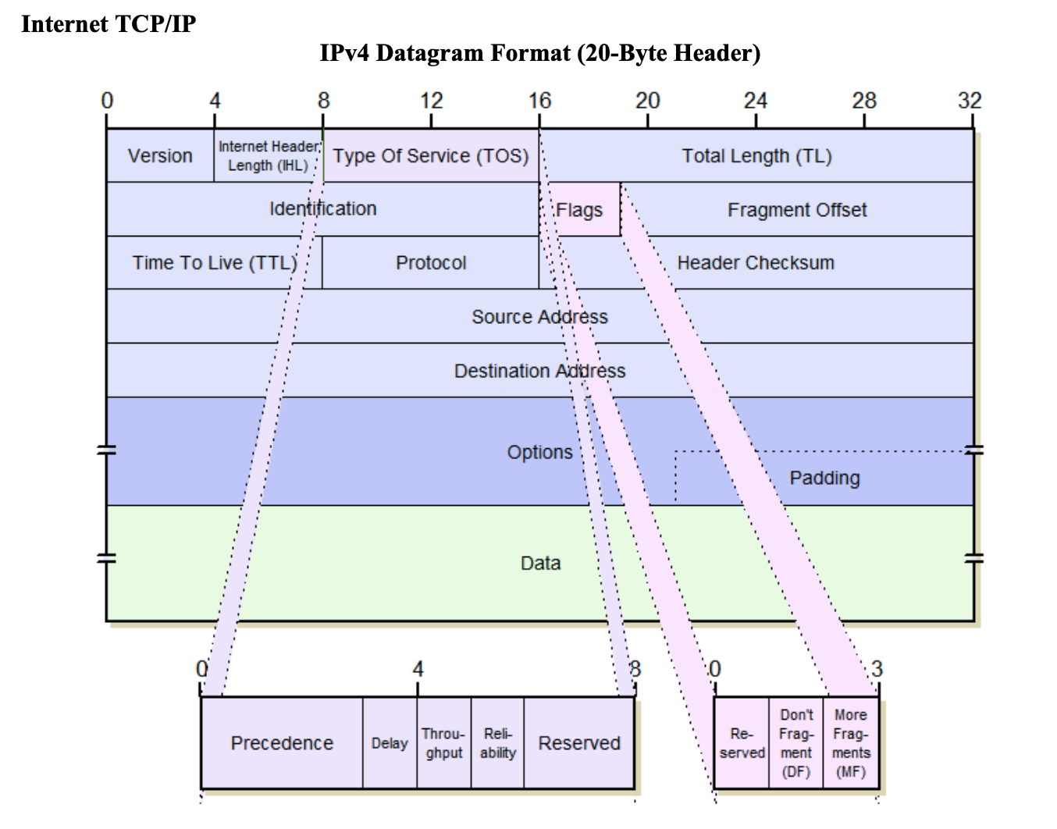
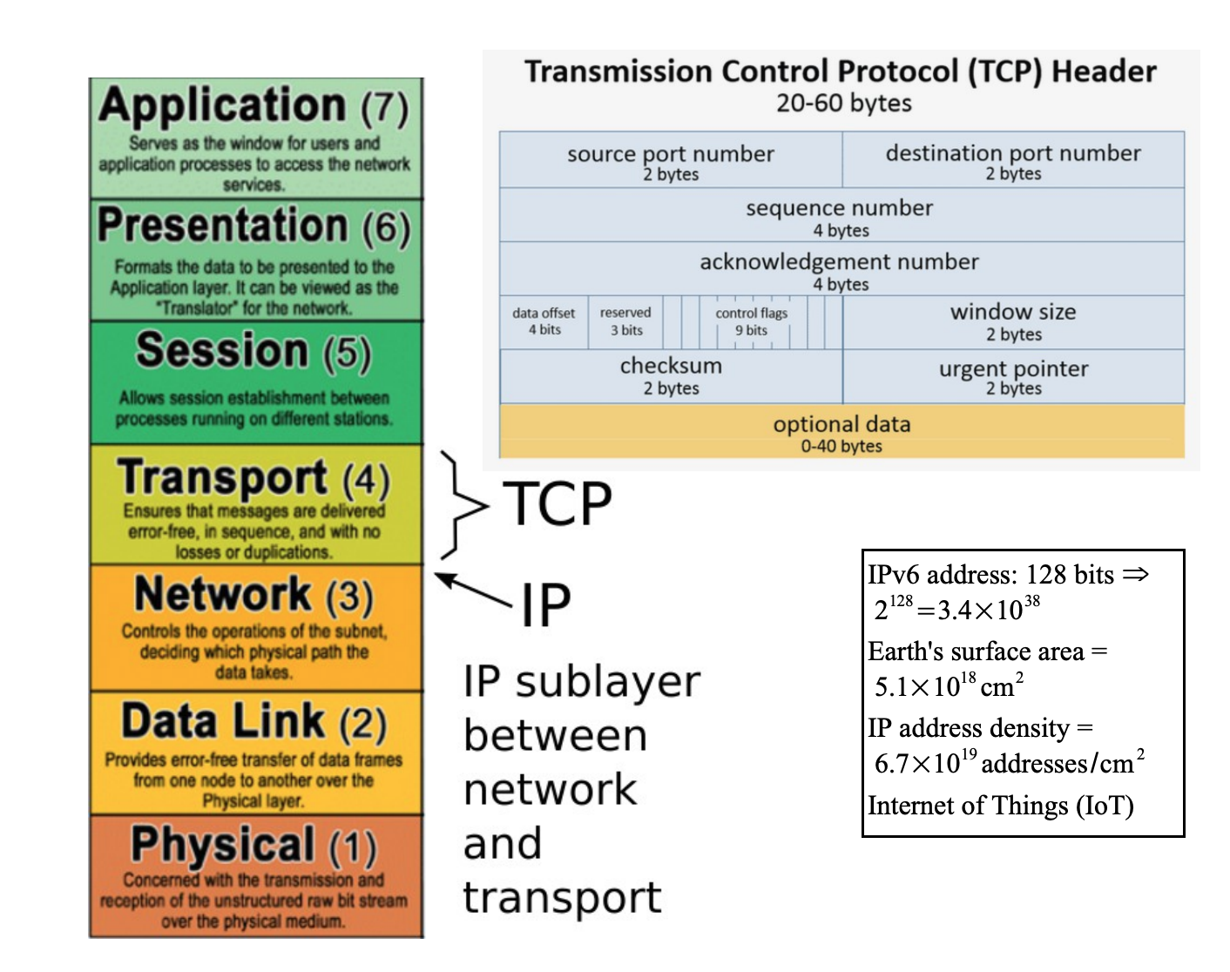

Slide 4
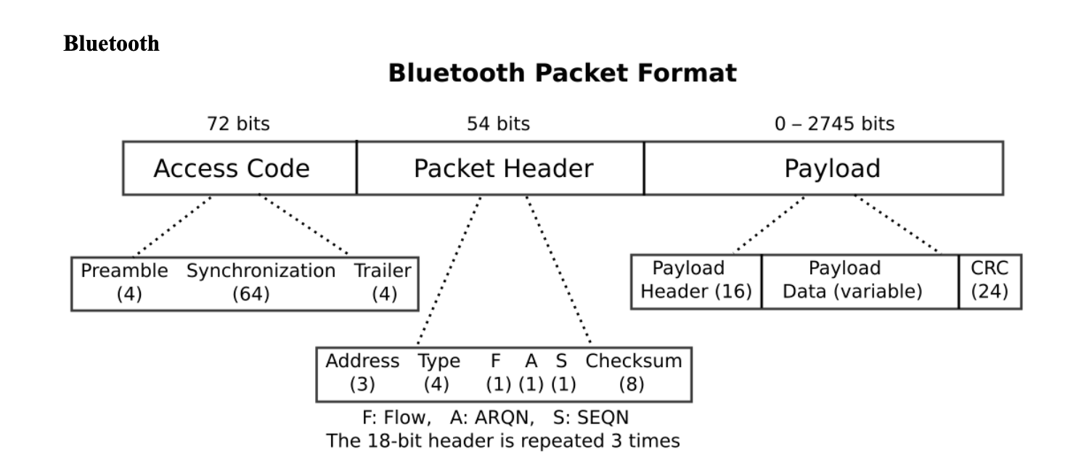
Continued
And I’m certain you’ve heard of Bluetooth

Slide 5
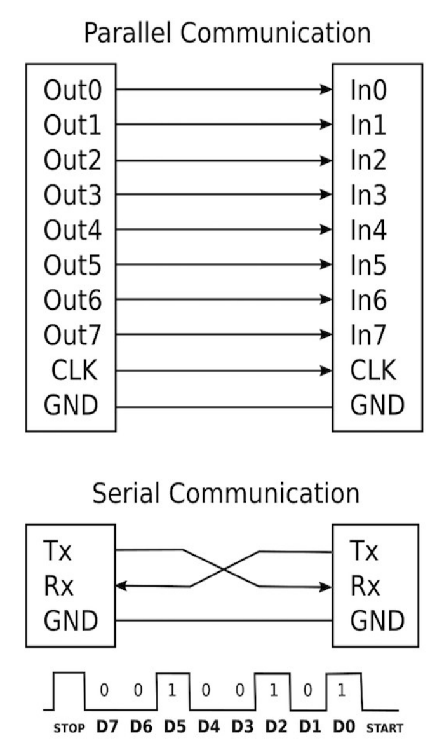
What does “Serial Communications” mean?
If the speed of transmission is the same, parallel will always be faster
But if you can be more than 8 times faster sending one bit one after the next, it’s about equal
And even if it’s not faster, it will very likely be easier and require significantly less hardware … and wires

Slide 6
So what?
These are complicated communications protocols requiring very specific hardware/software to implement
We want SIMPLE
But ”simple” almost always comes at a cost
And it’s usually performance
Over the years a number of simple protocols have been established
UART – universal synchronous receive and transmit’
SPI – serial peripheral interface
I2C – inter integrated circuit (this is us)
So how do we use simple devices (i.e. cheap) AND still get performance?

Slide 7
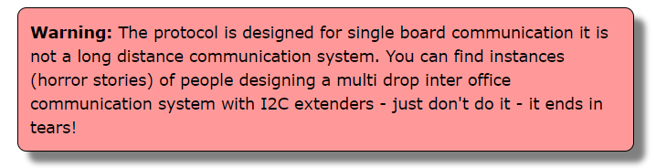
Cautionary tale about the I2C Protocol
And like any good engineer, we will ignore this advice!

Slide 8
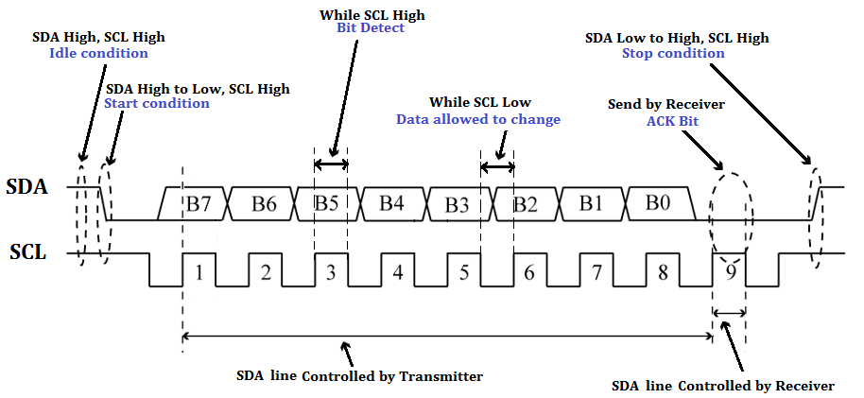
High level

Slide 9
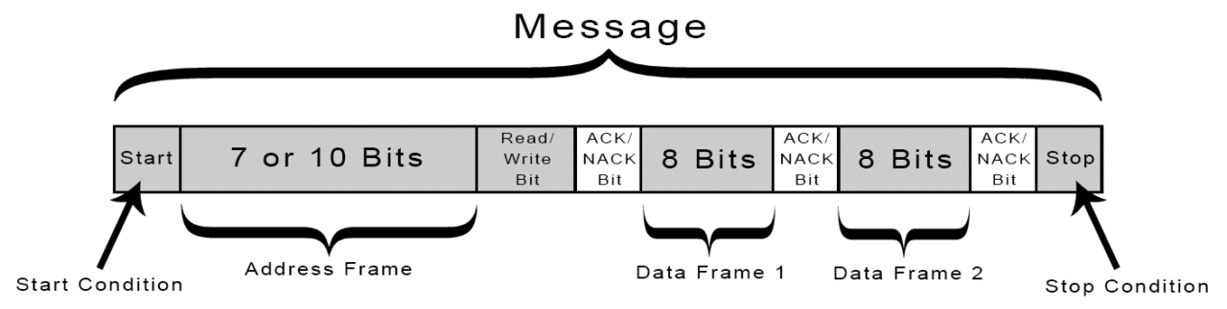
The message (data being sent)

Slide 10
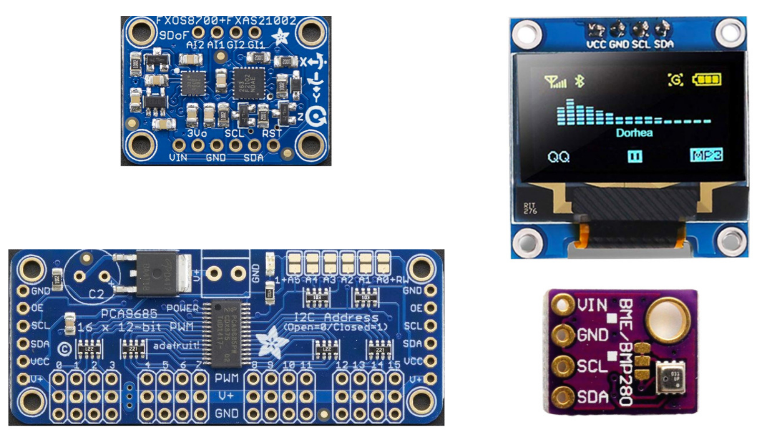
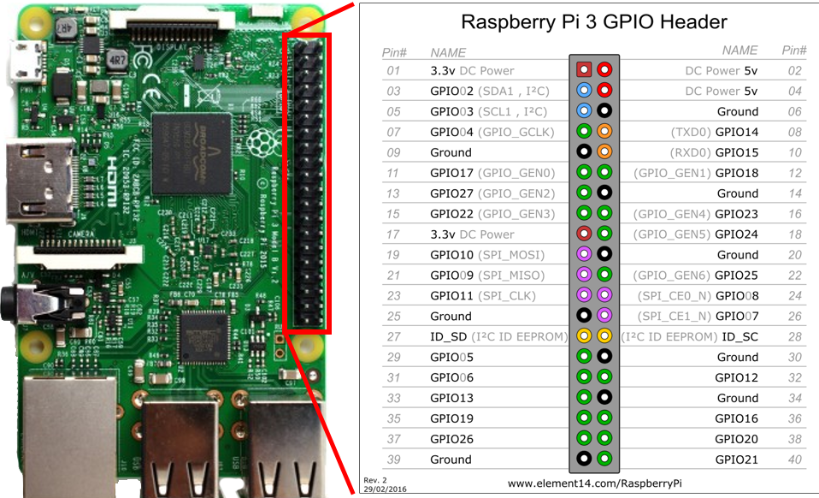
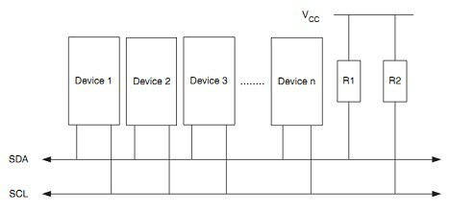
I2C on the RPi

Slide 11
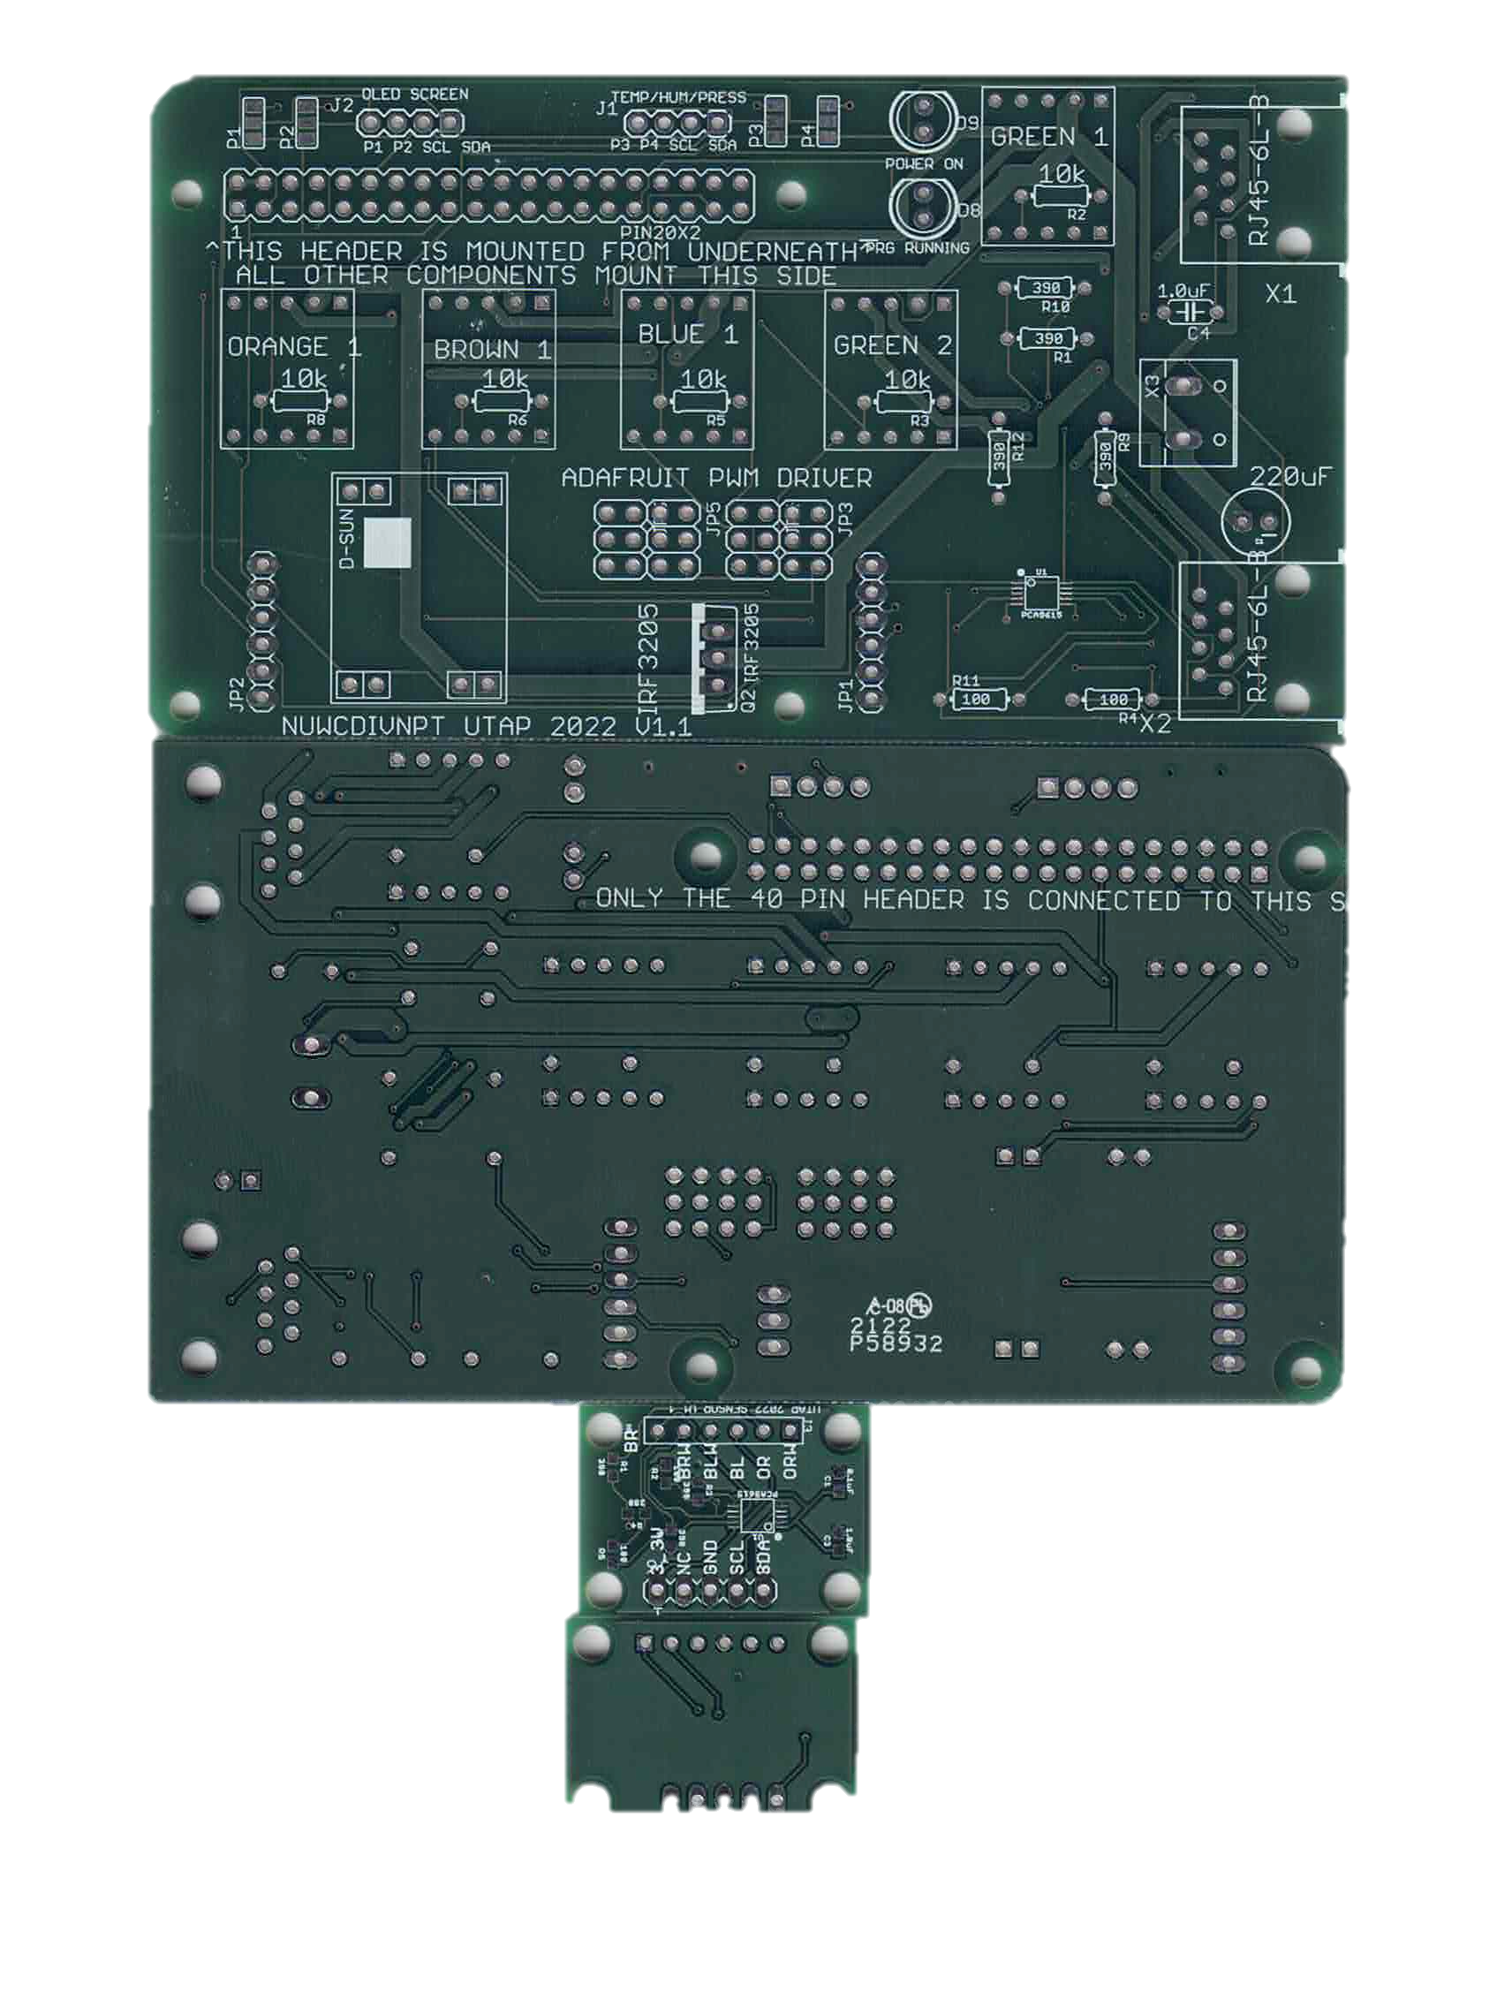
I2C on the PCB

Slide 12
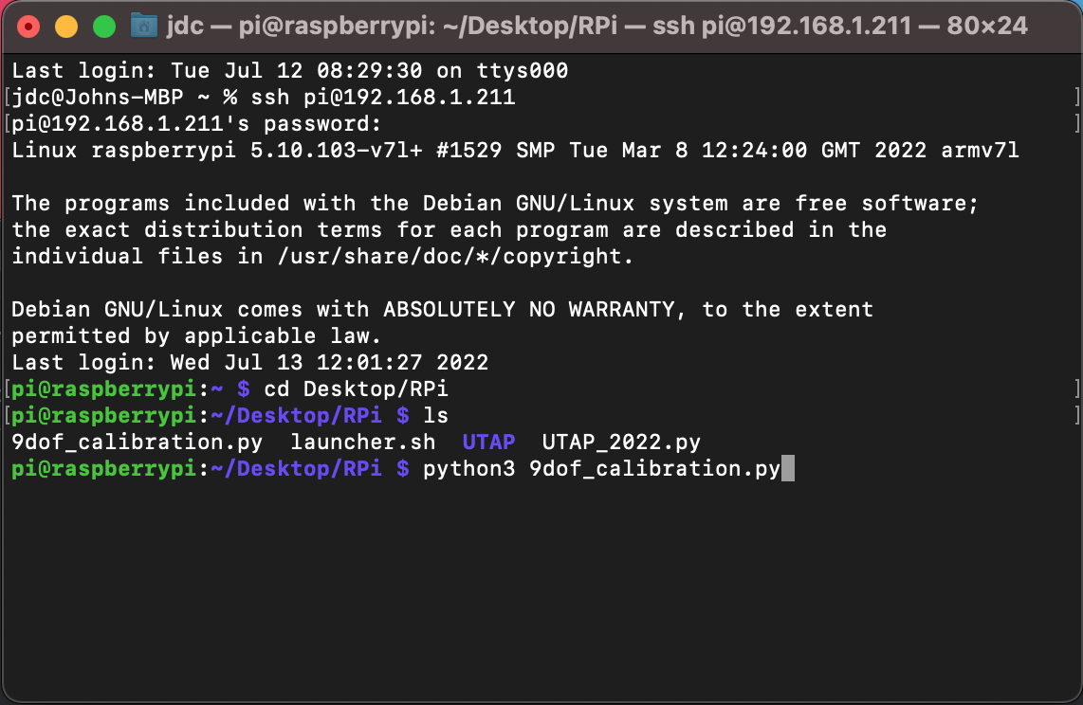
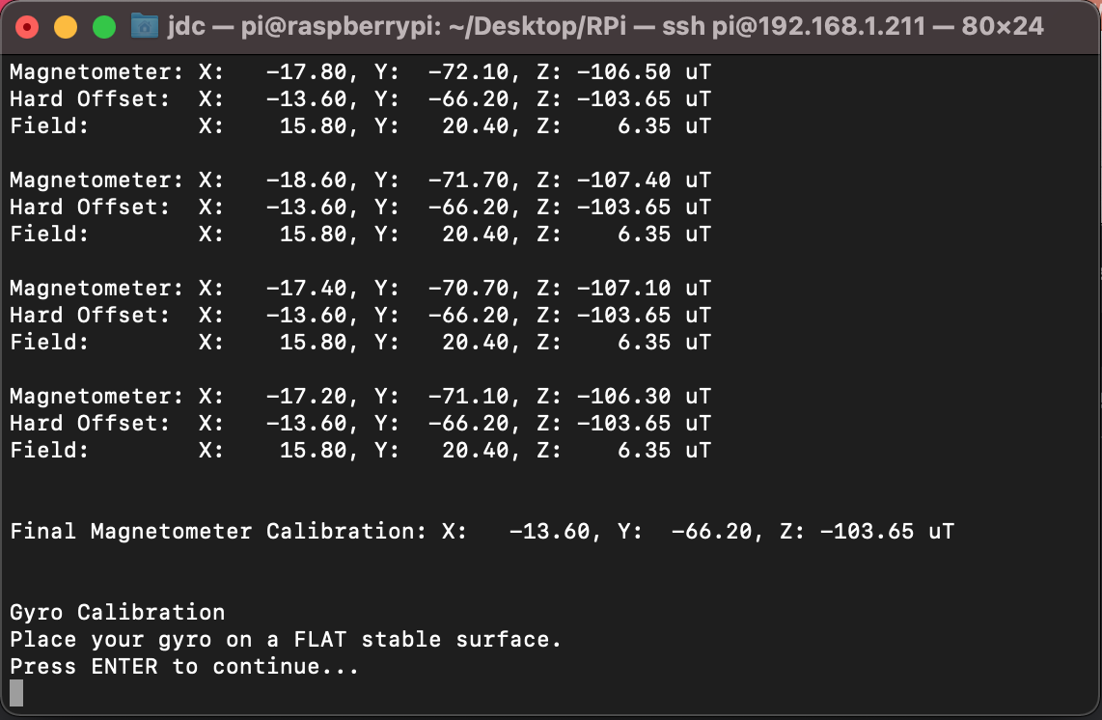
9 dof Sensor Calibration

Slide 13
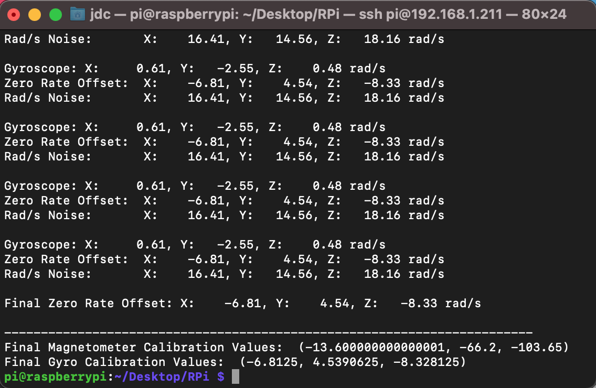
Calibration complete

Slide 14
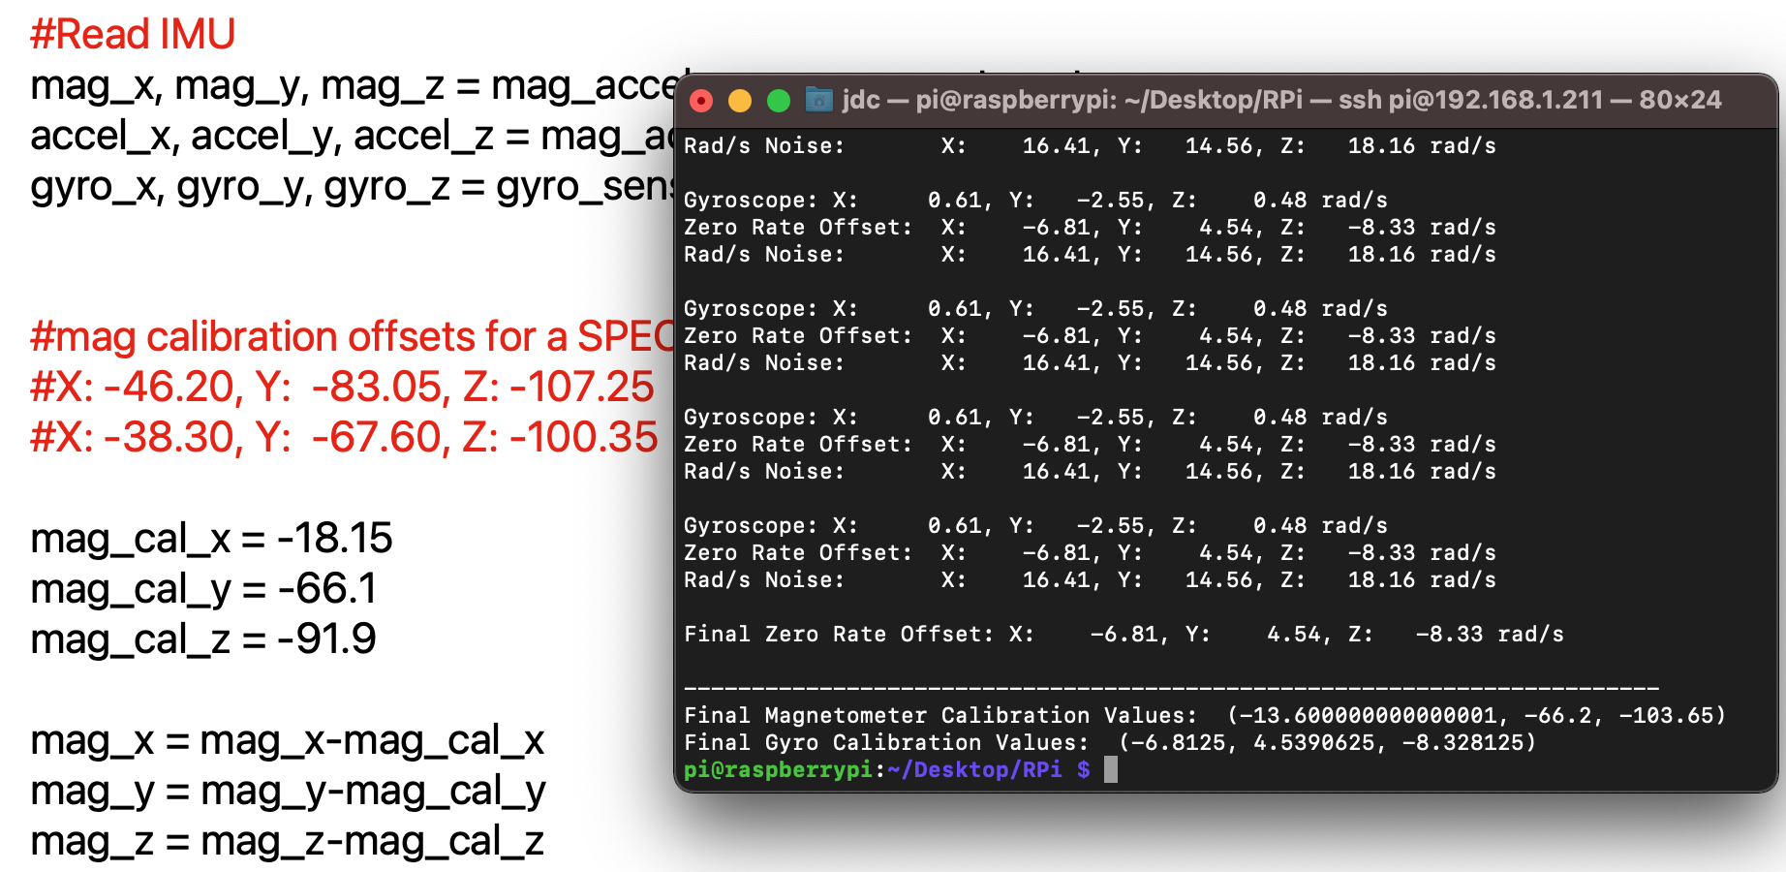
Update your calibration values

Slide 18
Ascii

Slide 19
Micro-ElectroMechanical Sensors (MEMSs)
https://www.youtube.com/watch?v=eqZgxR6eRjo

